Slide 1
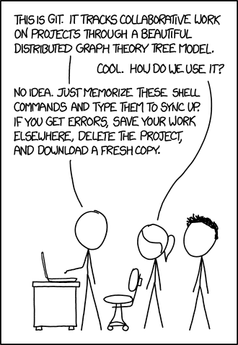
Git Version Control

Slide 2
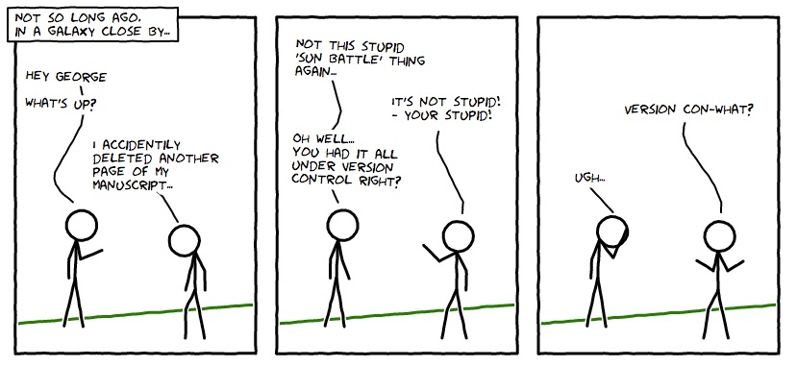
Git is a term of insult with origins in British English denoting an unpleasant, silly, incompetent, annoying, senile, elderly or childish person.

Slide 3
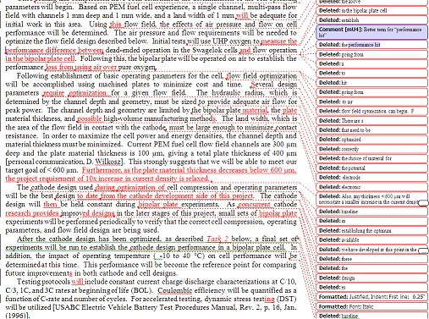
Microsoft Word Track changes

Slide 4
Microsoft Word Track changes
YIKES

Slide 5
The ‘diff’ tool can tell us about file changes
Based on the “Longest Common Subsequence” algorithm
It’s line based
Can show a set of line additions/deletions needed to make the second file from the first

Slide 6
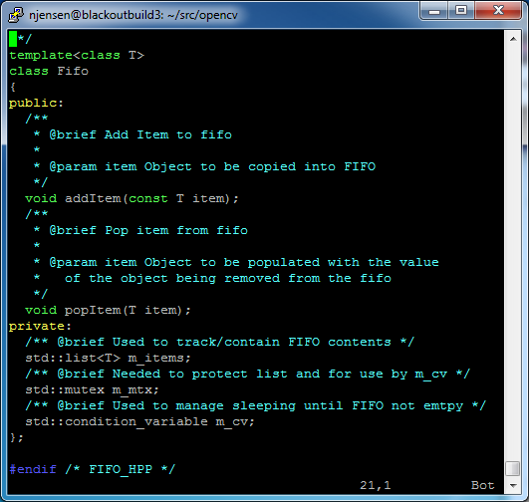
Diff Example:
Original File
New File
Changed to pass by ref

Slide 7
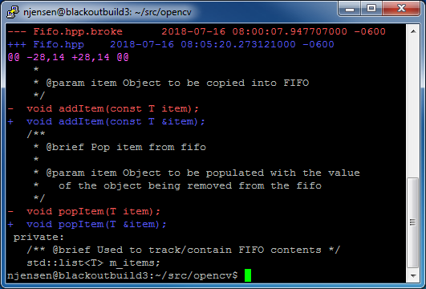
Diff Example: (patch file)
Old file details
New file details
Hunk Description
Begins at line 28 and runs for 14 lines in old file
Begins at line 28 and runs for 14 lines in new file
Changed “Hunk”
+ show added lines
- shows deleted lines

Slide 8
Here’s the paradigm shift:
In the real world, source can be long-lived
I have many source files more than 10 years old (an eternity)
They are still valuable, but they have changed over time
Today’s source file is yesterday’s file with a number of patches
I was going to list all the ways this was useful and cool, but I ran out of room. Let’s build our own list

Slide 9
On to the version control system
A complex code base is can be thought of merely a large set of patches (change sets)
My current code base has ~5000 change sets, and that is just since I migrated to git (three or four years ago)
A version control system:
Is an organized/automated way to manage all these change sets
Allows multiple people to exchange change sets
Identify and resolve when change sets conflict with each other
CVS, SVN, Mercurial, and Git are all version control systems
We’ll focus on Git

Slide 10
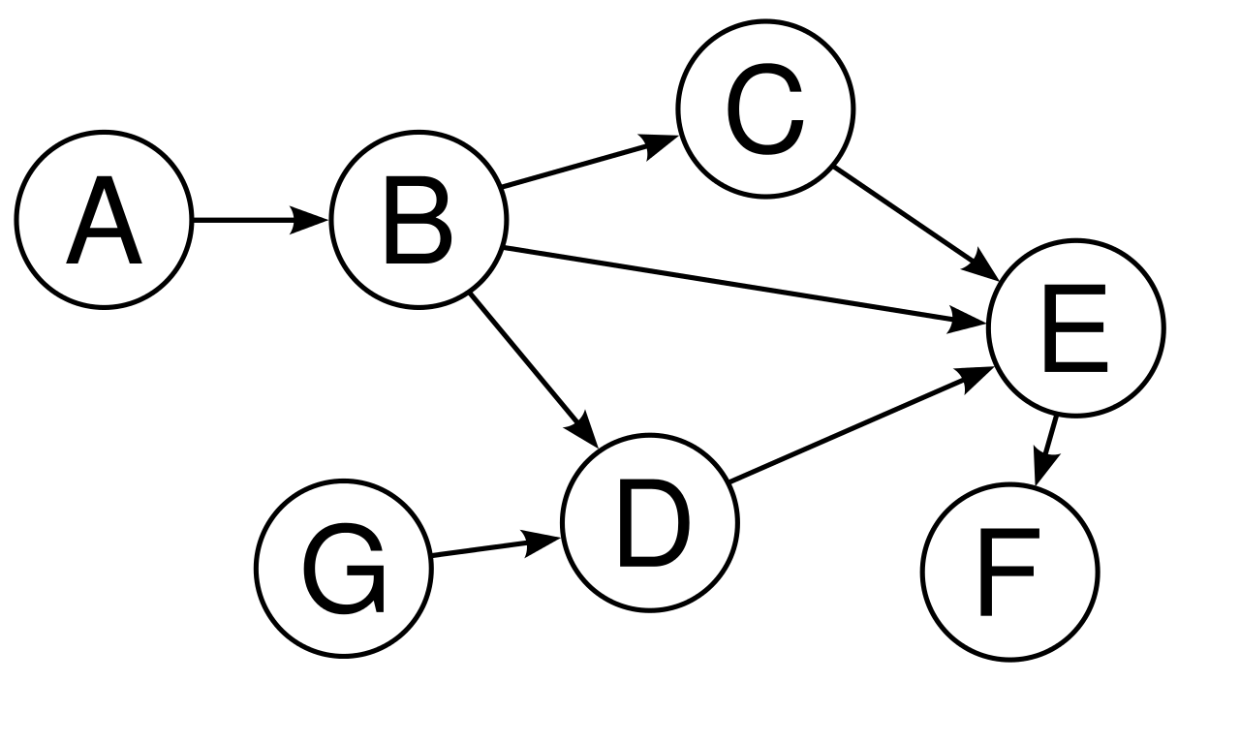
Directed Acyclical Graph (Awesome computer science content)
Vertex
Edge
Common/useful CS data structure
Has vertices and edges
Vertex has content
Edge shows relationships between content
Once again, I started listing cool things to build with DAGs – it’s too long
Let’s build our own list in class

Slide 11
Git manages change sets in a DAG
A vertex stores a change set
An edge points to the parent change set, (replay order)
The vertices are stored as simple files identified by a SHA-1 hash -- https://en.wikipedia.org/wiki/SHA-1
Git keeps pointers to certain change sets so we can “check out” our code at certain points
Change to by-ref passing
master
B
A
Original source
File

Slide 12
Git change sets can be pushed/pulled to/from other repositories
The pointers (references) are also moved
Could be on the same server or a different server via
http, file, ssh, or git protocols
Change to by-ref passing
master
B
A
Original source
File

Slide 13
Step 1: Developer clones repo
Bare Repo (origin)
Clone Repo
=>
master
Remotes/
origin/master
master
A
A

Slide 14
Step 2: Developer commits a change set
Bare Repo (origin)
Clone Repo
master
B
master
Remotes/
origin/master
A
A

Slide 15
Step 3: Developer pushes change set
Bare Repo (origin)
Clone Repo
<=
master
Remotes/
origin/master
master
B
B
A
A

Slide 16
Other Git functionality
Truly distributed nature
Multiple users
Branching and merging
Stashing
Bisecting
Rebasing
Conflict detection and resolution

Slide 17
In Class Exercise

